Slide 1
Distress, Coping, and Psychopathology in Patients with Psychogenic Non-epileptic Seizures
S. Marc Testa, Ph.D.

Slide 2
Overview
PNES: the basics
Review the PNES literature on:
  Distress and life events
  Coping
  Psychopathology
Present locally derived data on:
  Distress and life events
  Coping
  Psychopathology

Slide 3
PNES: The basics

Slide 4
What are psychogenic non-epileptic seizures????
“Psychogenic nonepileptic seizures (PNES) are episodes of paroxysmal impairment of self-control associated with a range of motor, sensory, and mental manifestations, which resemble those seen in epileptic seizures but are not associated with ictal electrical discharges in the brain. In most cases, PNES are interpreted as a dissociative response to psychological or social distress.”
  Lawton, Mayor, Howlett & Rueber (2009)

Slide 5
Differential is tricky
PNES need to be differentiated from ES
  However, patients can have both.
Other physiologic causes of paroxysmal events need to be ruled out:
  Syncope
  Hyperventilation
  transient ischemic attacks
  migrainous events
  hypoglycemia
  parasomnias

Slide 6
How common are PNES???
Annual Incidence:
  1.4 per 100,000
  Probably an underestimate.
Prevalence
  2-33 per 100,000
Annual costs: $110 million to $4 billion.
  Emergency room visits, hospital admissions, continued use of anti-epileptic medications, and unemployment.

Slide 7
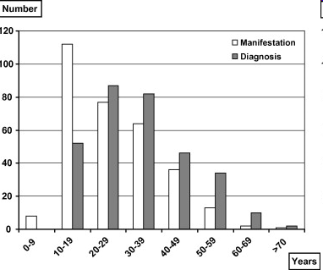
Age at onset
Average diagnostic delay is 7.2 years (N=313) (Reuber, 2002).

Slide 8
Age patterns
Typically begin in the 2nd or 3rd decade of life.
Younger age at onset is associated with better prognosis.
Older age at onset are equally common among men and women (however, overall ratio is 3:1 / Women:Men).
  More likely linked to health-related traumatic experience.

Slide 9
Distress and Life Events

Slide 10
Background
Most of the literature focuses on stressful life events.
Small portion of the literature acknowledges the differential impact of remote and recent stressful life events.
Few studies examine perception of stress.

Slide 11
Factors
It may be important to analyze stressful life event data by different time frames.
Predisposing
  Occur >12 months before onset of PNES
Precipitating
  Occur <12 months before onset of PNES
Perpetuating
  Are present after PNES diagnosis

Slide 12
Predisposing factors
Events occurring more than 12 months before the onset of symptoms:
  Trauma; 90% report trauma
  Family dysfunction
  Personality
    25-67% may fulfill criteria for personality DO
{

Slide 13
Predisposing factors
  Psychopathology
    22-84% have other somatoform DO
    22-91% have other dissociative DO
    35-49% Post-traumatic stress
    57-85% Depressive
    11-50% Anxiety
  Illness perceptions and coping
    Greater external locus of control than ES
    Stronger escape avoidance
    Experience life as more stressful.

Slide 14
Predisposing factors
  Cognitive Factors
    Perform poorly on neuropsychological tests
      May have some relationship to variable effort.
      PNES do better than ES when effort test failures are excluded.
  Neurobiological factors
    Up to 20% of PNES patients may have abnormal interictal EEG findings, MRI abnormalities or neuropsychological deficits.
    History of concussion

Slide 15
Precipitating factors
Events that occur within 12 months of symptom onset.

Slide 16
Precipitating factors
  Stress and dilemmas
    Rape
    Injury
    Giving birth
    Undergoing anesthetics
    Death or separation from family or friends
    Job loss
    Road/traffic accidents
    Earthquakes
    Relationship difficulties
    Legal action

Slide 17
Perpetuating factors
After a mean of 11 years following manifestation and 4 years after diagnosis:
  66% of PNES patients still have seizures
  >50% are occupationally disabled
    41.4% on health grounds
    12.4% unemployed
    Mean age 38.6 years

Slide 18
Perpetuating factors
Health care contacts
  Repetitive investigations and different explanations from different doctors.
Social/financial Illness gain
  Acquisition of a “sick role” offloads unpleasant responsibilities onto others.
  More likely than patients with ES to receive health-related state benefits!!!!

Slide 19
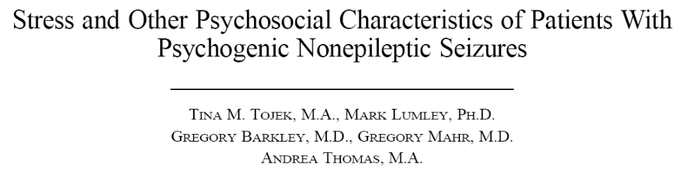
Psychosomatics 2000, 41: 221-226

Slide 20
Tojek et al. (2000)
Compared 25 PNES to 33 ES
Surveyed:
  Negative life events
  Perceived stressfulness
  Frequency that patients think about them

Slide 21
Tojek et al. (2000)
In addition to assessing anxious, depressive and psychotic symptoms, they also assessed:
  General somatic symptoms
  Stress-related physical disorders
  Illness worry
  Bodily awareness
  Alexithymia

Slide 22
Tojek et al. (2000)
Psychiatric Symptoms (Brief Symptom Inventory)
  PNES had:
    More somatic symptoms
    marginally more anxious and depressive symptoms.
    Greater bodily awareness
  No differences related to alexithymia or illness worry.

Slide 23
Tojek et al. (2000)
Results
  PNES reported:
    Higher prevalence of stressful life events
    Higher mean rating of stressfulness
    More frequent ruminations about stressful life events.
  PNES experienced more:
    Physical abuse as an adult
    Serious illness or death of a close friend
    Marital discord
    Serious alcohol or drug problem

Slide 24
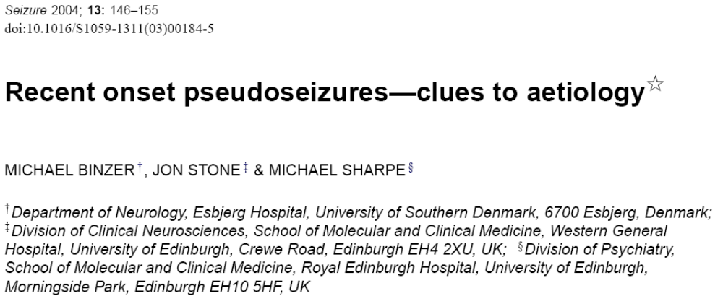

Slide 25
Binzer et al. (2004)
Compared 20 PNES to 20 ES
  Looked at recent (<12 months) life events related to:
    Work
    Family life
    Health problems among friends and relatives
    Events related to patient’s own health problems
  More life events in PNES than ES
    PNES perceived life events as more negative, unexpected and difficult to adjust to than ES.
    PNES reported more Life events related to personal health issues!!!

Slide 26
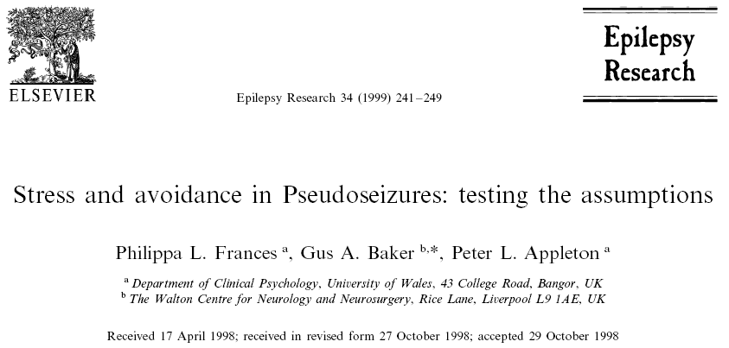
Frances et al., 1999

Slide 27
Frances et al., 1999
30 PNES, 30 ES, 30 HV
PNES may represent avoidant or emotionally distancing coping strategy which is applied when the person perceives the demands of life as exceedingly stressful.
Hypotheses
  PNES will appraise their ongoing life situations as more stressful than ES and HV.
  PNES are more likely to use escape-avoidant and distancing coping strategies and less likely to use planful-problem solving coping strategies than ES and HV.

Slide 28
Frances et al., 1999
Measures
  Perceived Stress Scale
    14 items that focus on the extent to which respondents find their lives unpredictable, uncontrollable, and overloaded.
  Ways of Coping
    Measures 8 coping strategies
    Participants are asked to think of a stressful situation that occurred in the last week and then complete questionnaire

Slide 29
Frances et al., 1999
Perceived stress was higher in PNES than HV, but equal to ES.
Limitation: Did not link perceived distress to any particular life domain (e.g., work, family, health).

Slide 30
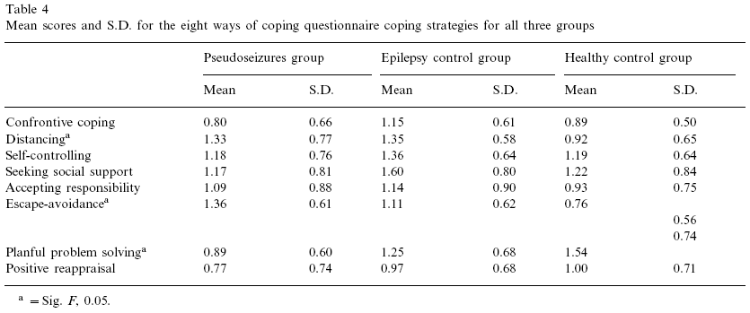
Coping – Frances et al.

Slide 31
Discussion – Frances et al.
More escape avoidance in PNES
  Supports notion that PNES are part of an avoidant behavioral repertoire.
  Future research should compare PNES and HV with similar stress levels.
    Could Frances et al. (1999) have co-varied for perceived stress?
Isn’t planful-problem solving the inverse of escape-avoidance?
  Effect sizes are nearly identical.

Slide 32
More Coping

Slide 33
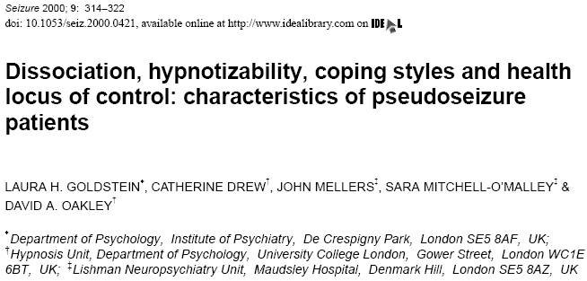
Goldstein et al. (2000)

Slide 34
Goldstein et al. (2000)
Compared PNES (N=20) to the “general population” (N=20)
Hypotheses:
  Higher levels of dissociation
    (Dissociative Experiences Scale; DES, self-rated questionnaire)
    (Perceptual Alteration Scale; PAS, self-rated questionnaire)
  More emotion-focused coping style
    (Ways of Coping Questionnaire; WOC)
    8 Coping Factors
  Greater hypnotic susceptibility
    (The Creative Imagination Scale; CIS)
    (Tellegen Absorption Scale; TAS)
  Also included Hamilton Anxiety and Depression Scales

Slide 35
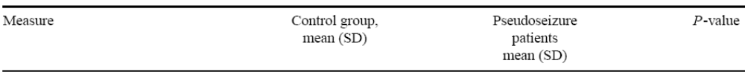
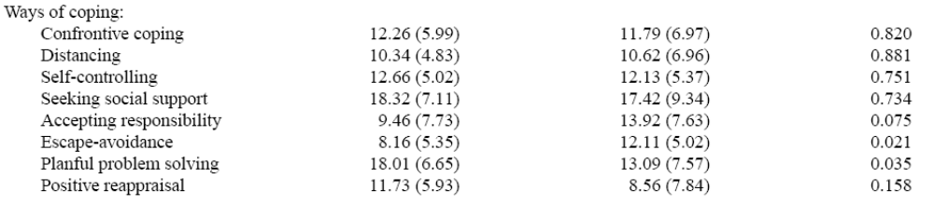
Goldstein et al. (2000)
The Ways of Coping are consistent with Frances et al. (1999).

Slide 36
Goldstein et al. (2000)
PNES had:
  Higher dissociation
  Greater belief in an external control over health
More depressive symptoms.
NO elevation in hypotizability.
  Control participants scored higher in absorption (a significant predictor of hypnotizability)
Control group had higher NART scores
  However, because NART was not correlated with DES or WOC, no covariate analyses were performed.

Slide 37
More on the DES
28 questions about experiences that individuals may have in daily life:
  ‘Some people have the experience of being in a familiar place but finding it strange and unfamiliar’;
  ‘Some people find evidence that they have done things that they do not remember doing’.
Experiences are rated on a scale of:
  0% (never have the experience) to
  100% (always have the experience)
The overall score is the mean of the individual question scores
A total score of 30 and above identifies those who may be strongly dissociative.
  In Goldstein et al. (2000)
    PNES = 22
    HV = 13
The mean DES score for adults in the general population is 7.831
A large Canadian sample the mean score was 10.8132.

Slide 38
Explanations of
Goldstein et al. (2000)
DES correlated significantly with escape-avoidance coping in both groups.
No PNES subgroups existed on DES via examination of the frequency distribution.
  i.e., no one really scored above 30 pts.
  75% of the patient group was in treatment
Couldn’t Depressive symptoms explain DES results?
  Inattention, slowed cognition, lack of interest in surroundings?

Slide 39
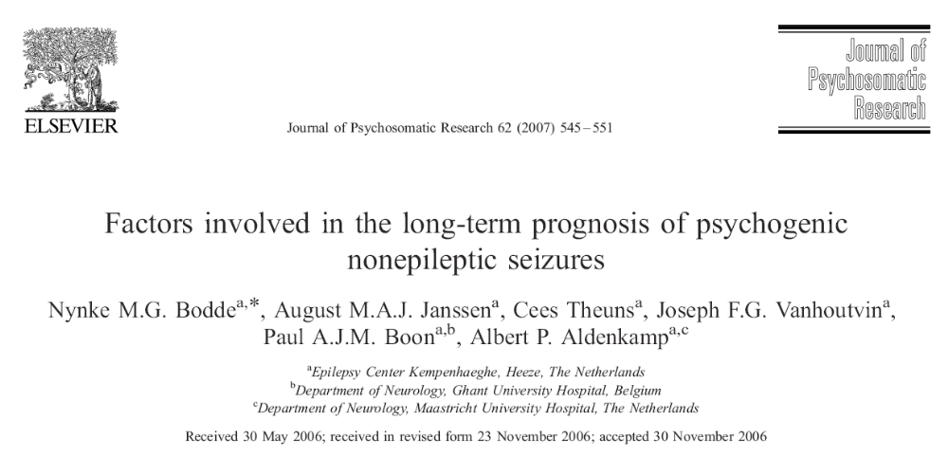

Slide 40
Bodde et al. (2007)
22 PNES patients
Longitudinal, observational study
  Follow-up 4-6 years.

Slide 41
Bodde et al. (2007)
Measures
  SCL-90-R
  Dissociation Questionnaire
  83 item Dutch MMPI
    Negativism
      high scores reflect negative, dissatisfied and hostile attitude toward others.
    Somatization
    Shyness
    Psychopathology
      delusional feelings, paranoid thoughts, bizarre experiences.
    Extraversion

Slide 42
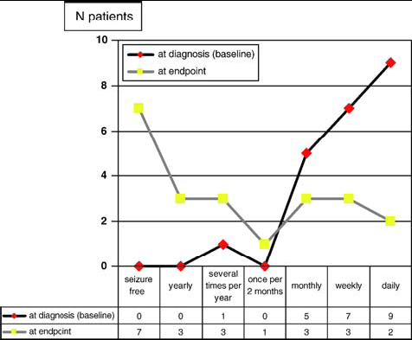
Bodde et al. (2007)
Seizure frequency of PNES at baseline and endpoint

Slide 43
Bodde et al. (2007)
Baseline characteristics
  Results are difficult to interpret as the authors do not make any non-PNES comparisons.
However, there were reductions in:
  Psychological distress (SCL-90-R)
  Identity confusion (DIS)
  Amnesia (DIS)
  Negativeness (MMPI)

Slide 44
Bodde et al. (2007)
Increases were observed on:
  Extraversion (MMPI)
    Interpreted to reflect more active and energetic attitude toward social contacts.
    Self-control.
Found that higher baseline psychopathology (MMPI) and negativeness (MMPI) was associated with worse outcome.

Slide 45
Psychopathology

Slide 46
MMPI Summary
Many studies focus on the classification accuracy of the of the MMPI
Elevation on scales 1 (Hs) and 3 (Hy) are more likely in PNES than ES.
  Combined with non-psychometric variables classification rates are 86%.
    Shorter chronicity of seziures

Slide 47
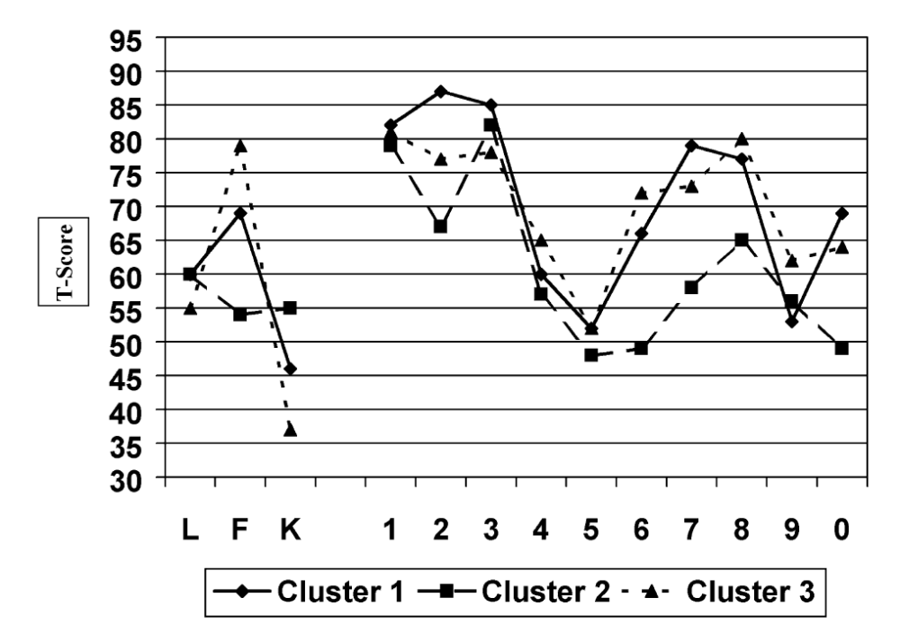
Typical MMPI Profiles

Slide 48
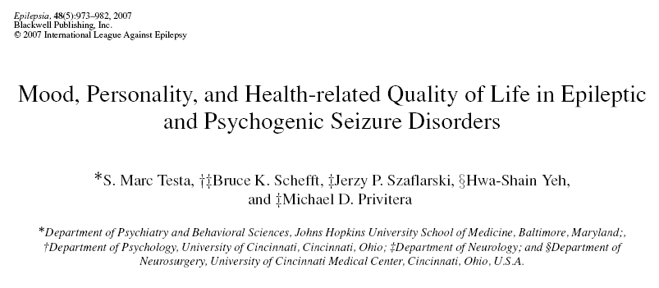

Slide 49
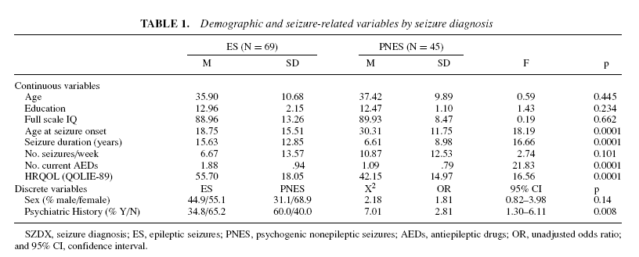
Group Characteristics (Testa, et al.)

Slide 50
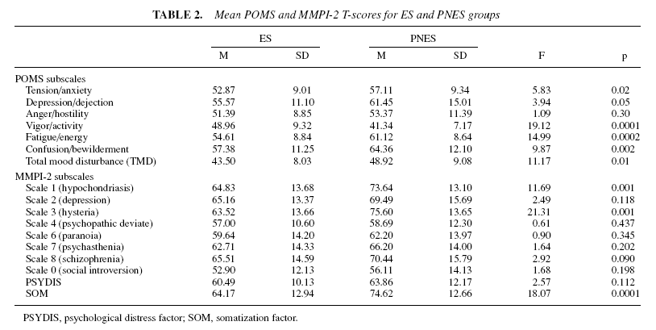
POMS and MMPI (Testa et al.)

Slide 51
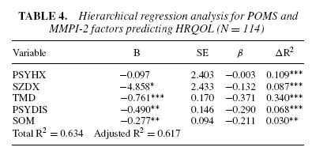
Key results (Testa et al.)

Slide 52
Personality
Assessment Inventory
2 or 3 studies
The first was:
  Wagner et al. (2005)
    26 PNES and 15 ES

Slide 53
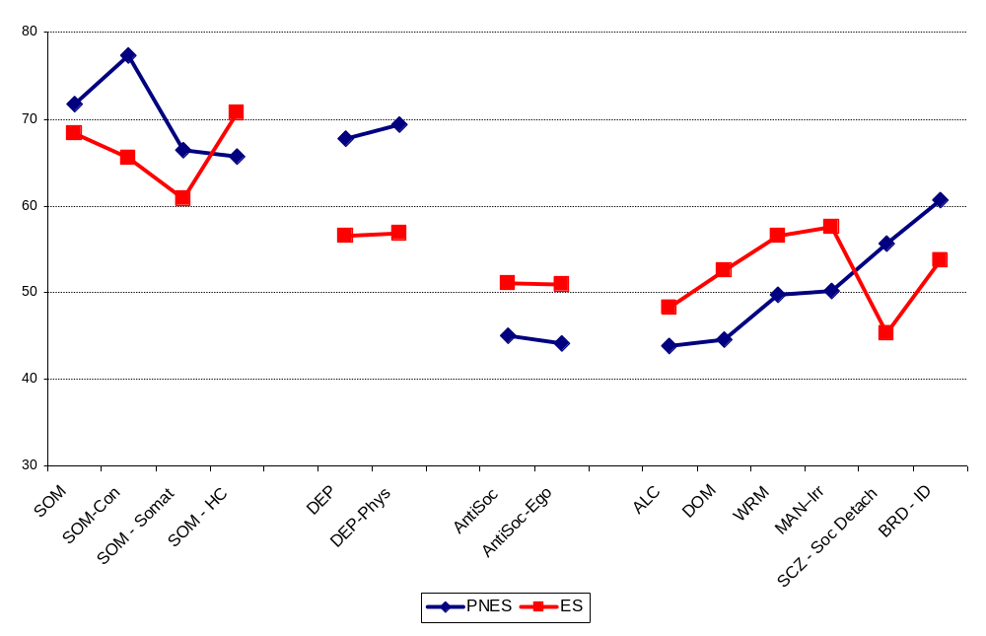
Wagner Results

Slide 54
Wagner et al. (2005)
Classification
NES Indicator scale
Conversion - Health Concerns
  Positive scores
    high conversion/lower health concerns
  Negative scores
    low conversion/higher health concerns
  Group differences (p = 0.0001).
  84% sensitivity and 73.3% specificity for the diagnosis of PNES versus ES

Slide 55
Local Results
Initial data collection included:
  NEO PI-R
  PAI
  QOLIE-31
  Wonderlic
  Implicit Association Test

Slide 56
Local Results
The second phase of data collection added:
  PERI
    Psychiatric Epidemiology Research Interview Life Events Scale
  COPE
Unless otherwise noted, these analyses will focus on the subset of individuals who received all measures.

Slide 57
Inclusion/Exclusion
ES and PNES participants were EMU inpatients
Classification regarding seizure status was made by experienced neurologists with expertise in EEG and epilepsy.

Slide 58
Inclusion/Exclusion
Patients with their typical events recorded on video-EEG were included.
  Probable PNES was defined when at least one typical event is recorded on video-EEG with normal background rhythm and no concomitant EEG discharge.
  Probable ES was characterized as the simultaneous occurrence of at least one stereotypic event and an epileptiform EEG discharge.

Slide 59
Inclusion/Exclusion
  Data obtained from subjects with other diagnostic outcomes, such as possible ES or PNES or physiological non-epileptic events (e.g., syncope or sleep-related myoclonus) will not be used in primary analyses.
  Healthy volunteers were recruited from the Johns Hopkins Hospital community and Craig’s List ads.

Slide 60
Inclusion/Exclusion
Older than 18 years-old and younger than 65.
English as their preferred language
No known mental retardation.
IQ above 70
Healthy volunteers
  No severe psychiatric illness, substance abuse or dependence in the prior 12 months, or significant medical disease.

Slide 61
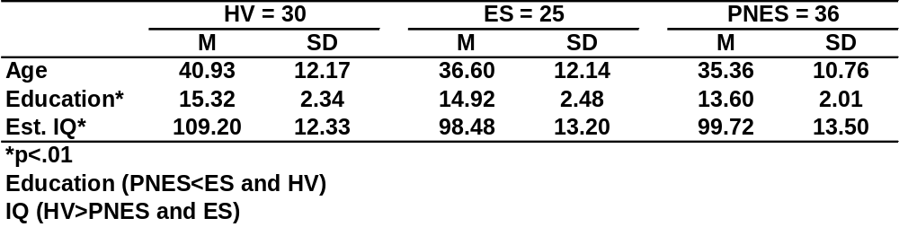
Participant
Characteristics

Slide 62
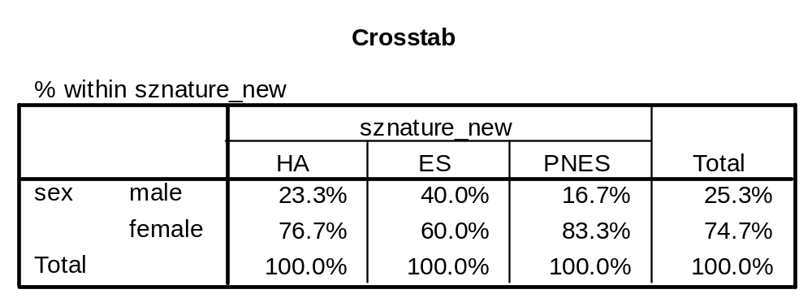
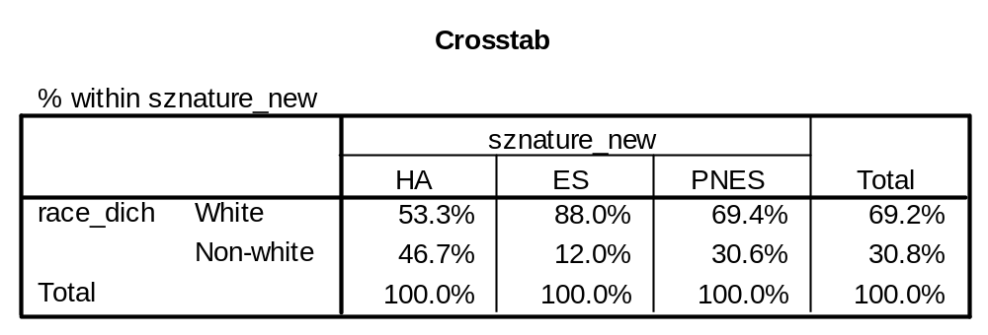
Sex and Race
There are no sex differences.
Race is more evenly distributed in the HV group than the other groups.

Slide 63
Questions to this point
What is the proper comparison?
  PNES vs. ES ???
  PNES vs. HV
PNES do not have a neurological disorder
  Would we compare patients with psychogenic blindness to individuals who were actually blind?
Nor are they psychiatrically normal

Slide 64
Answers???
Comparing the psychogenic group to the actual patient group they mimic may help provide information useful to classification.
  In a clinical situation, which tests suggest the presence of a psychogenic component.
To identify targets for psychotherapy, for instance, comparison to healthy adults would seem most reasonable.

Slide 65
Stressful Life Events
PERI
  Lists 104 stressful life events that participants rate for frequency of occurrence in the last 1-5 years and in the last year.
  They are asked to rate the distress they experienced with each event on a 0 (No Distress) to 100 (Maximal Distress) scale.

Slide 66
Recent Life Events
Frequencies for recent stressful life events did not differ between groups.
Group differences emerged when various life domains were considered.

Slide 67
Stressful Life Events by Domain
Residence (recent)
  Healthy adults report more stressful life events related to their residence.
Health (recent)
  PNES report more stressful life events related to their health then ES and HV.
No group differences emerged for remote stressful life events.

Slide 68
Distress
Overall distress did not differ across groups.
Crime and Legal
  PNES>HV
Health
  PNES>ES and HV
  ES>HV

Slide 69
Crime and Legal Items
Was assaulted.
Was robbed.
Accident in which there were no injuries.
Involved in a law suit.
Accused of something for which a person could be sent to jail.
Arrested.
Lost driver’s license.
Went to jail.
Got involved in a court case.
Convicted of a crime.
Acquitted of a crimes.
Released from jail.
Didn’t get out of jail when expected.

Slide 70
Health Items
Physical health improved.
Physical illness.
Injury.
Unable to get treatment for an illness or injury.

Slide 71
Caveats to
Life Events Analysis
Not all stressful life events are negative.
  Analyses should consider this issue.
    For instance work-related stress could include getting laid off or getting promoted.
  Updated analyses suggest:
    PNES report the same number of positive and negative stressful life events as ES and HV
    PNES report more distress associated with NEGATIVE life events.

Slide 72
COPE
A 60-item multidimensional inventory.
Fifteen coping styles are assessed
  Respondents report (using a 4 point Likert scale) the extent to which they usually do the things listed when they are stressed.
  1 = I usually don't do this at all
  2 = I usually do this a little bit
  3 = I usually do this a medium amount
  4 = I usually do this a lot
Each scale has 4 items.

Slide 73
COPE Scales
  Positive reinterpretation and growth
  Mental disengagement
  Focus on and venting of emotions
  Use of instrumental social support
  Active coping
  Denial
  Religious coping
  Humor
  Behavioral disengagement
  Restraint
  Use of emotional social support
  Substance use
  Acceptance
  Suppression of competing activities
  Planning

Slide 74
Pitfalls of Measuring Coping
There are many different ways to cope.
One might not cope the same way across all stressful events.
Probably, very difficult to measure
  Self-reported coping may not reflect reality.
The COPE should be considered a measure of self-reported coping.

Slide 75
COPE RESULTS
Univariate ANOVA (Group x COPE Scale)
  Significant differences:
    Positive reinterpretation and growth
      HV>ES
    Active coping
      HV>PNES and ES
    Denial
      PNES and ES > HV
    Planning
      HV > PNES and ES

Slide 76
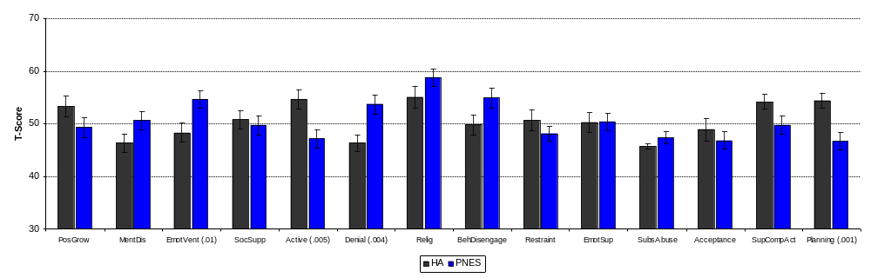
HV vs. PNES

Slide 77
Scales and Items
Focus on and Venting of Emotions
  I get upset and let my emotions out.
  I get upset, and am really aware of it.
  I let my feelings out.
  I feel a lot of emotional distress and I find myself expressing those feelings a lot.

Slide 78
Active Coping
  I concentrate my efforts on doing something about it.
  I take additional action to try to get rid of the problem.
  I take direct action to get around the problem.
  I do what has to be done, one step at a time.

Slide 79
Denial
I say to myself "this isn't real."
I refuse to believe that it has happened.
I pretend that it hasn't really happened.
I act as though it hasn't even happened.

Slide 80
Planning
I make a plan of action.
I try to come up with a strategy about what to do.
I think about how I might best handle the problem.
I think hard about what steps to take.

Slide 81
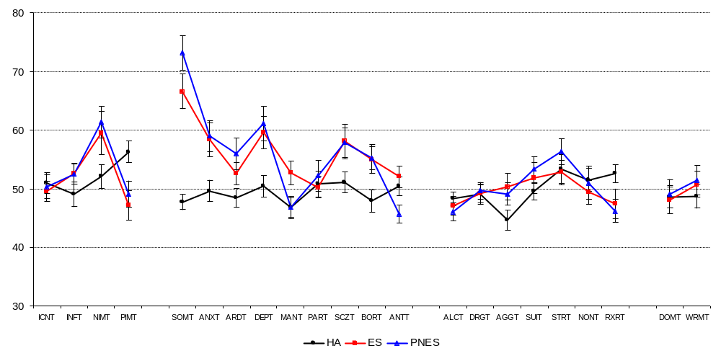
PAI Results*
*Subsample of those who received COPE and PERI

Slide 82
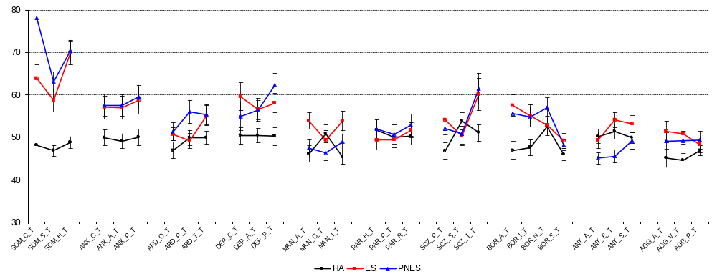
PAI - Subscales

Slide 83
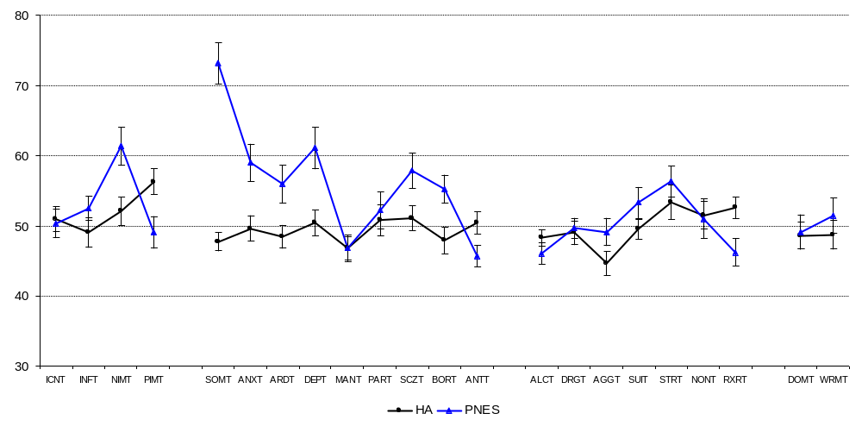
Excluding ES

Slide 84
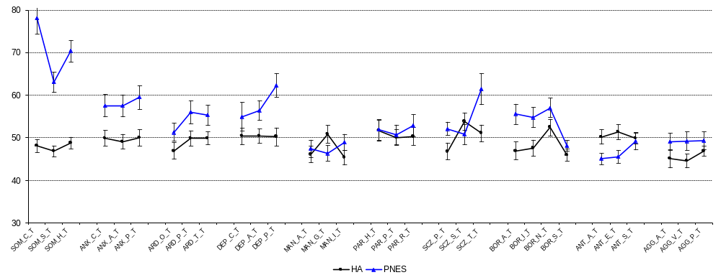
Excluding ES - Subscales

Slide 85
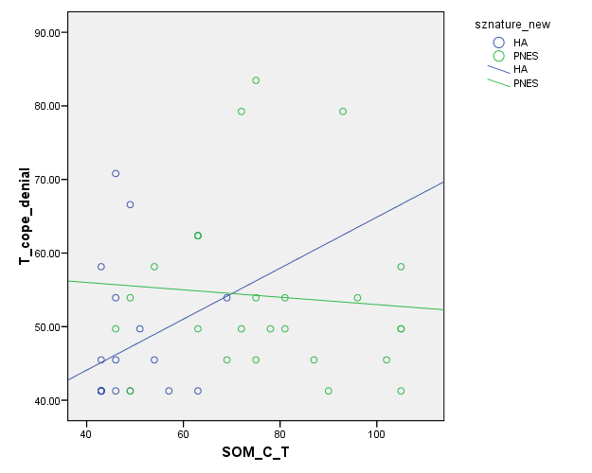
Correlations??

Slide 86
Subgroups?
One possible next step is to divide sample into subgroups that have been proposed previously (Gumnit and Gates, 1986 or Rusch et al., 2001)
  Acute anxiety
  Impaired affect regulation
  Somatization/conversion
  Depression
  Post-traumatic
  Reinforced behavior pattern

Slide 87
Acknowledgements
Support and Guidance
Jason Brandt, Ph.D.
Gregory L. Krauss, M.D.
Ronald Lesser, M.D.
EMU Attendings
Gregory Bergey, M.D.
Nathan Crone, M.D.
Eileen Vining, M.D.
Research Assistants
Jung Geum Im, M.A.
Sarini Ettigi , M.A.
Shaina Fieldstone, B.A.
Epilepsy Fellows
Mackenzie Cervenka, M.D.
Susan Shaw, M.D.

